Slide 1
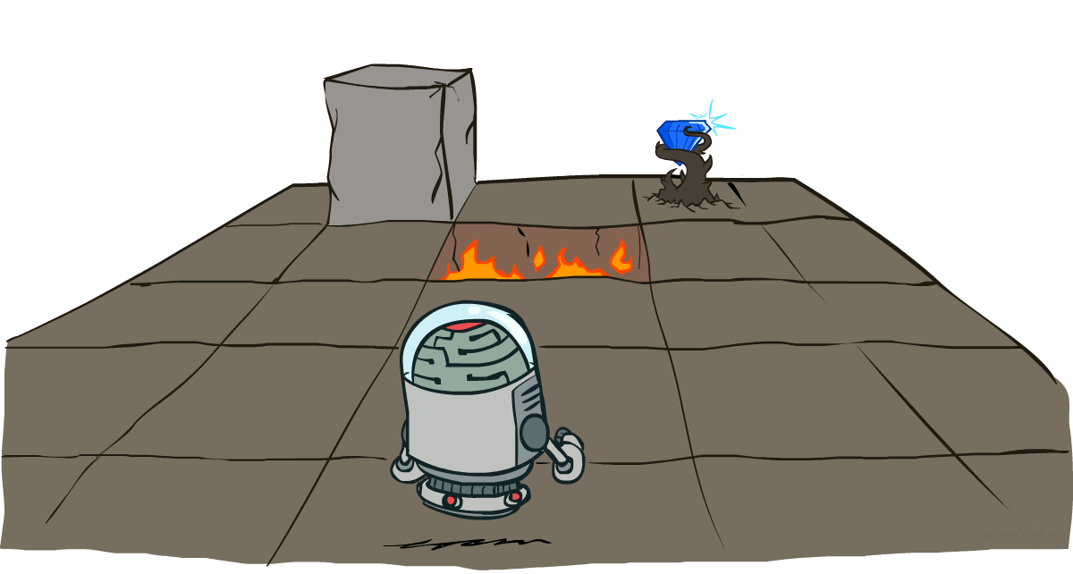
Week 13:
Markov Decision Processes Russell & Norvig, Chapter 17.
(Most of slides from Dan Klein and Pieter Abbeel)

Slide 2
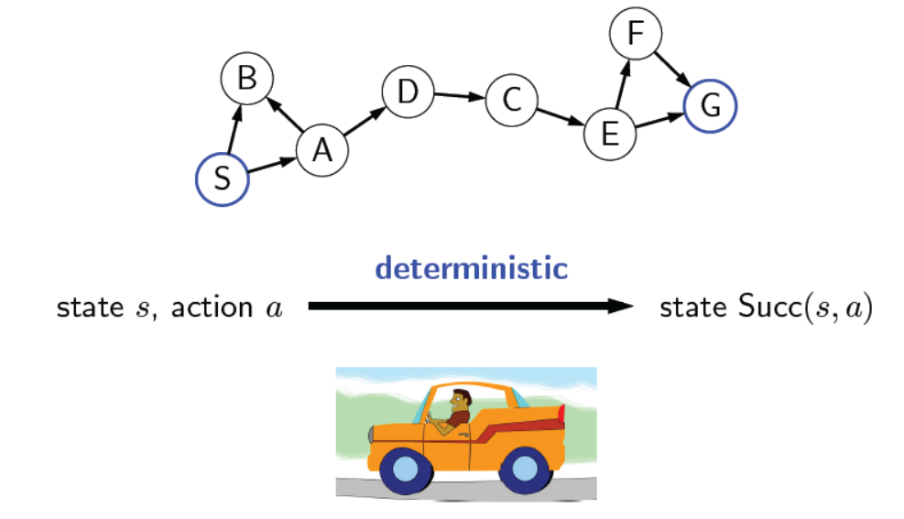
So far: Search Problems

Slide 3
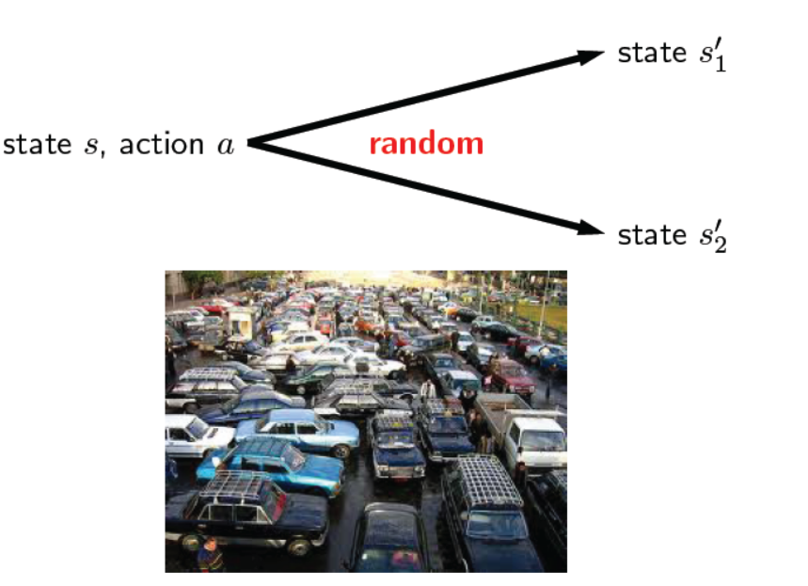
Uncertainty in the real world

Slide 4
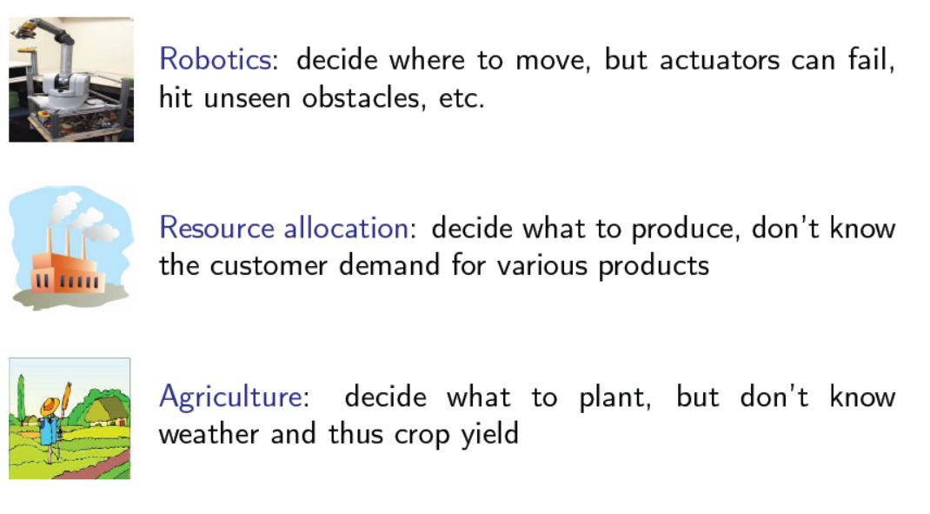
Applications

Slide 5
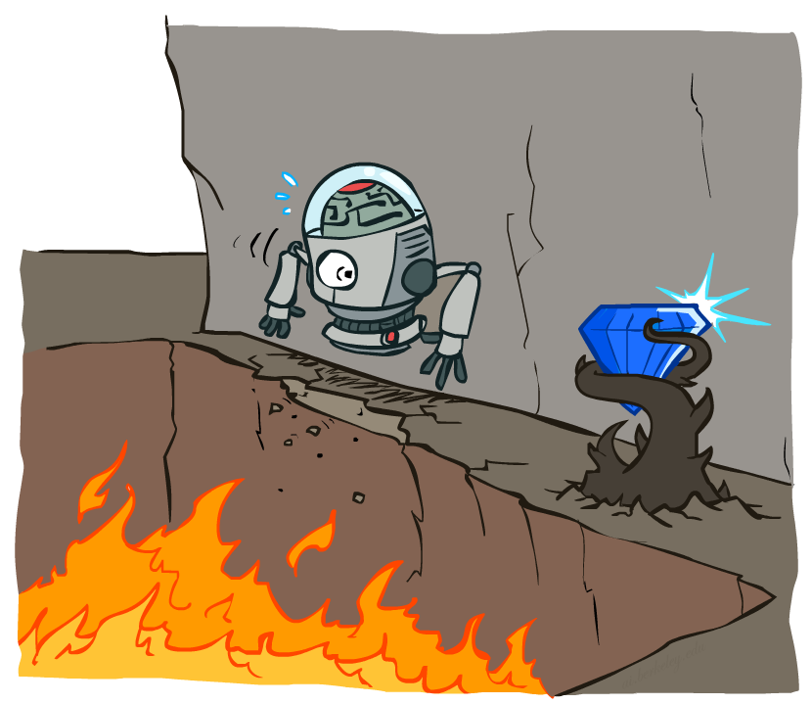
Non-Deterministic Search

Slide 6
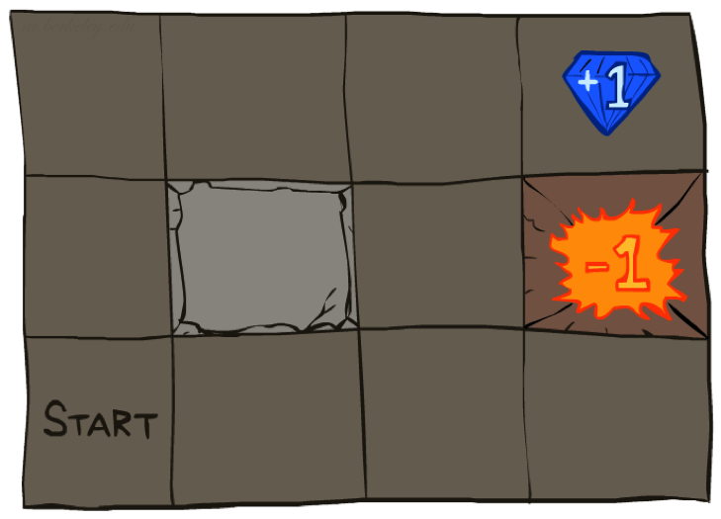




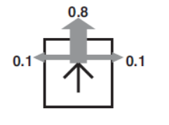
Example: Grid World
A maze-like problem
The agent lives in a grid
Walls block the agent’s path
Noisy movement: actions do not always go as planned
80% of the time, the action Up takes the agent Up (if there is no wall there)
10% of the time, Up takes the agent left; 10% right
If there is a wall in the direction the agent would have been taken, the agent stays put
The agent receives rewards each time step
Small “living” reward each step (can be negative)
Big rewards come at the end (good or bad)
Goal: maximize sum of rewards
Notes:
[cut demo of moving around in grid world program]

Slide 7
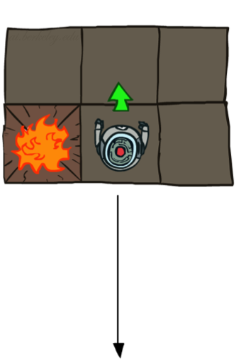
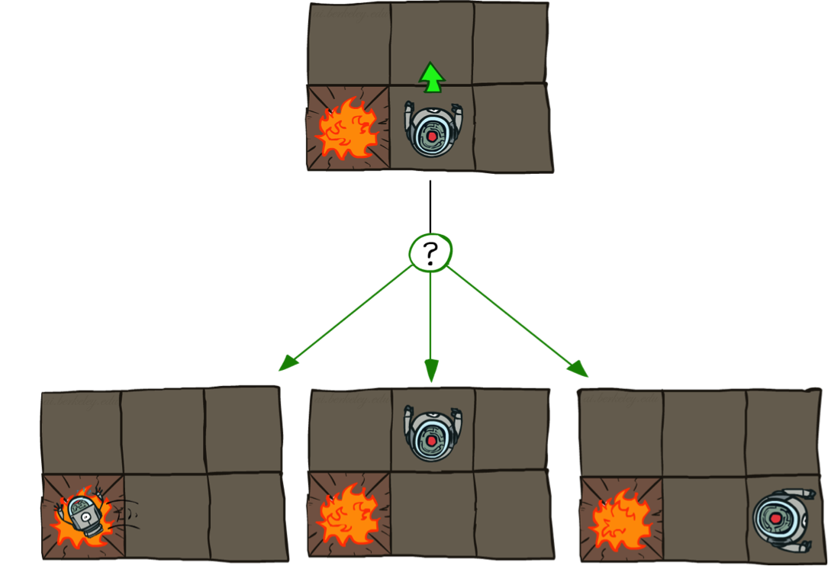
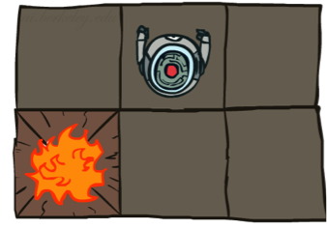
Grid World Actions
Deterministic Grid World
Stochastic Grid World

Slide 8
Markov Decision Processes
An MDP is defined by:
A set of states s ∈ S
A set of actions a ∈ A
A transition function T(s, a, s’)
Probability that a from s leads to s’, i.e., P(s’| s, a)
Also called the model or the dynamics
A reward function R(s, a, s’)
Sometimes just R(s) or R(s’)
A start state
Maybe a terminal state
MDPs are non-deterministic search problems
[Demo – gridworld manual intro (L8D1)]
Notes:
In search problems: did not talk about actions, but about successor functions --- now the information inside the successor function is unpacked into actions, transitions and reward
Write out S, A, example entry in T, entry in R
Reward function different from the book : R(s,a,s’)
In book simpler for equations, but not useful for the projects.
Need to modify expectimax a tiny little bit to account for rewards along the way, but that’s something you should be able to do, and so you can already solve MDP’s (not in most efficient way)

Slide 9
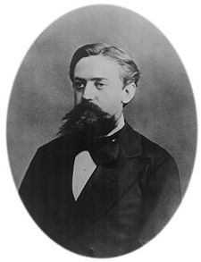

What is Markov about MDPs?
“Markov” generally means that given the present state, the future and the past are independent
For Markov decision processes, “Markov” means action outcomes depend only on the current state
This is just like search, where the successor function could only depend on the current state (not the history)
Andrey Markov (1856-1922)
Notes:
Like search: successor function only depended on current state
Can make this happen by stuffing more into the state;
Very similar to search problems: when solving a maze with food pellets, we stored which food pellets were eaten

Slide 10
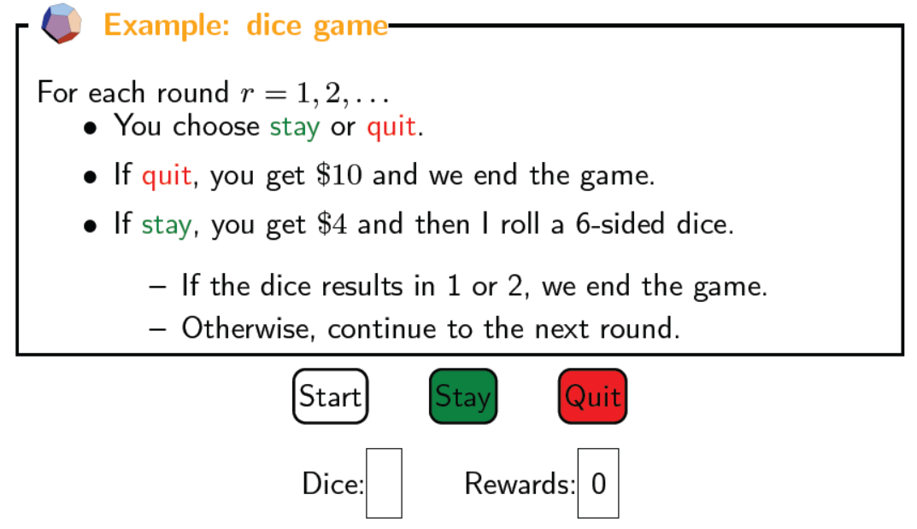
Dice game

Slide 11
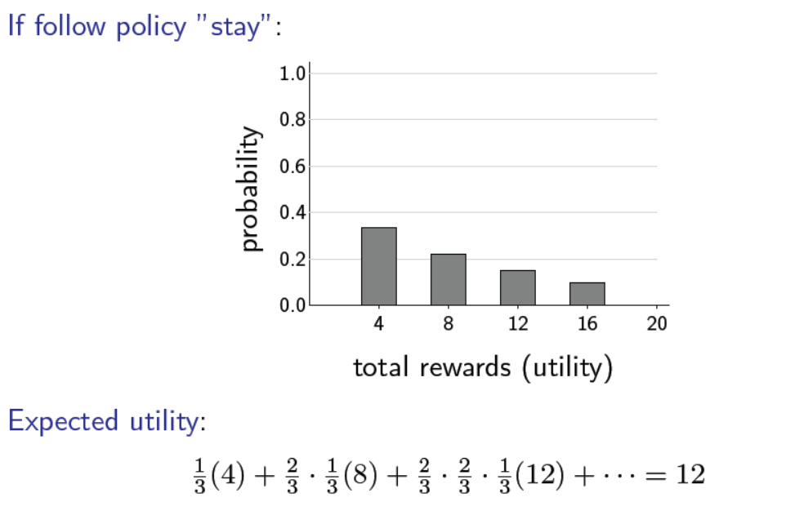
Rewards

Slide 12
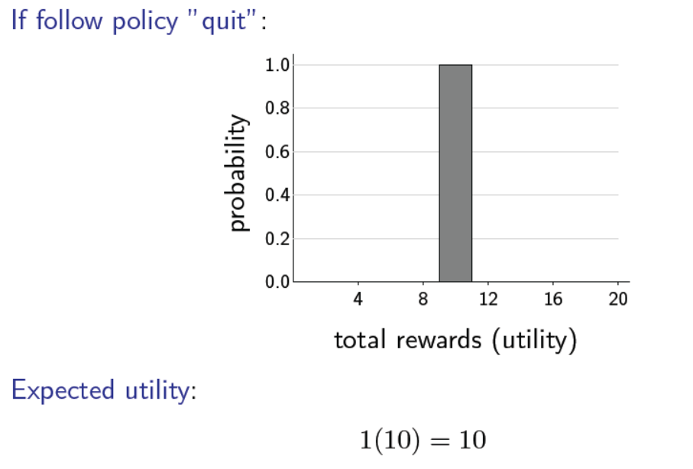
Rewards

Slide 13
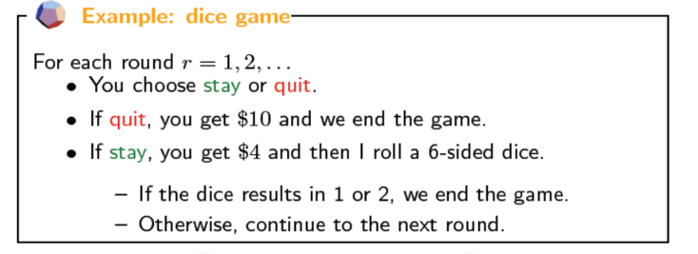
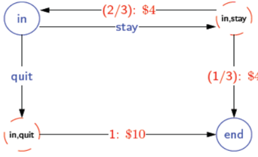
MDP of Dice Game

Slide 14
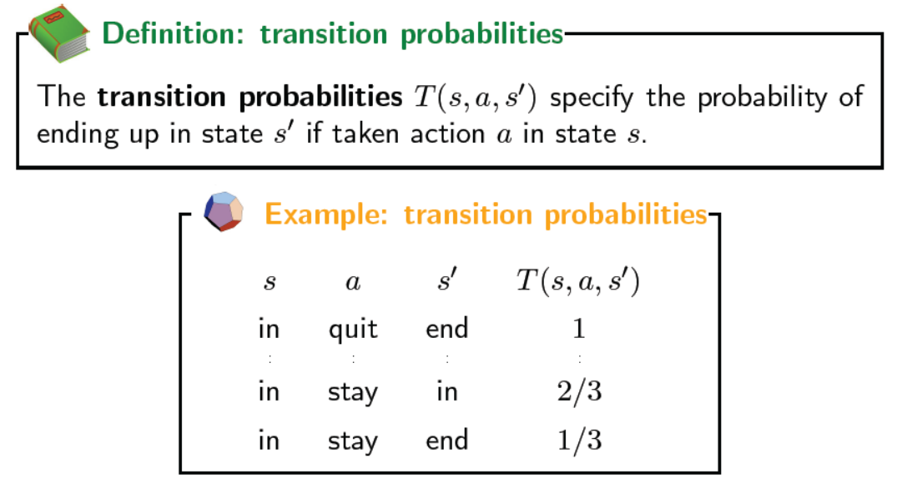
MDP of Dice Game

Slide 15




Dice Game Search Tree

Slide 16
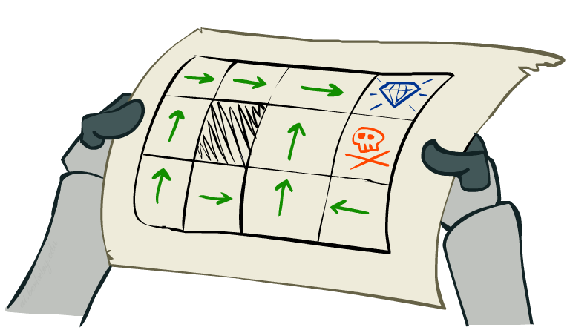
Solution (Policies)
In deterministic single-agent search problems, we wanted an optimal plan, or sequence of actions, from start to a goal
For MDPs, we want an optimal policy π*: S → A
A policy π gives an action for each state
An optimal policy is one that maximizes expected utility if followed
An explicit policy defines a reflex agent
Optimal policy when R(s, a, s’) = -0.03 for all non-terminals s
Notes:
Dan has a DEMO for this.

Slide 17
Optimal Policies
R(s) = -0.01
R(s) = -0.03
R(s) = -0.4
R(s) = -2.0
Notes:
R(s) = the “living reward”

Slide 18
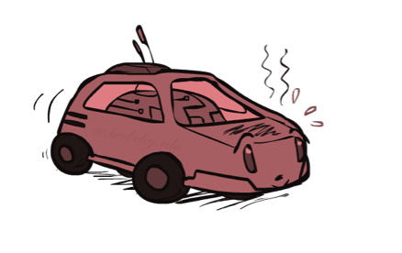
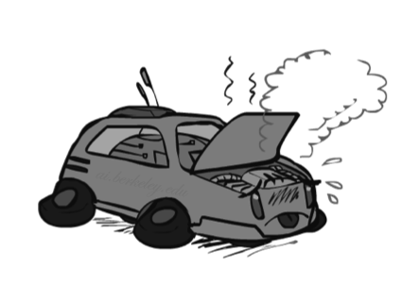
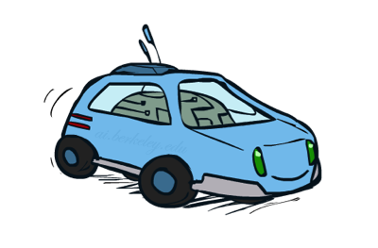
Example: Racing
A robot car wants to travel far, quickly
Three states: Cool, Warm, Overheated
Two actions: Slow, Fast
Going faster gets double reward
0.5
+1
1.0
Fast
Slow
-10
+1
0.5
Warm
Slow
Fast
0.5
+2
Cool
0.5
Overheated
+1
1.0
+2

Slide 19


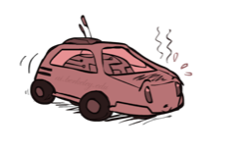
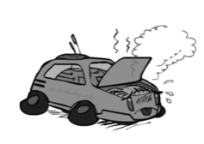
Racing Search Tree

Slide 20
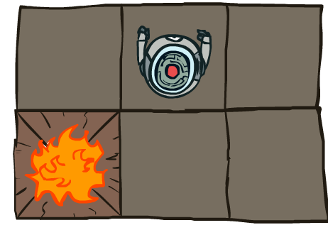
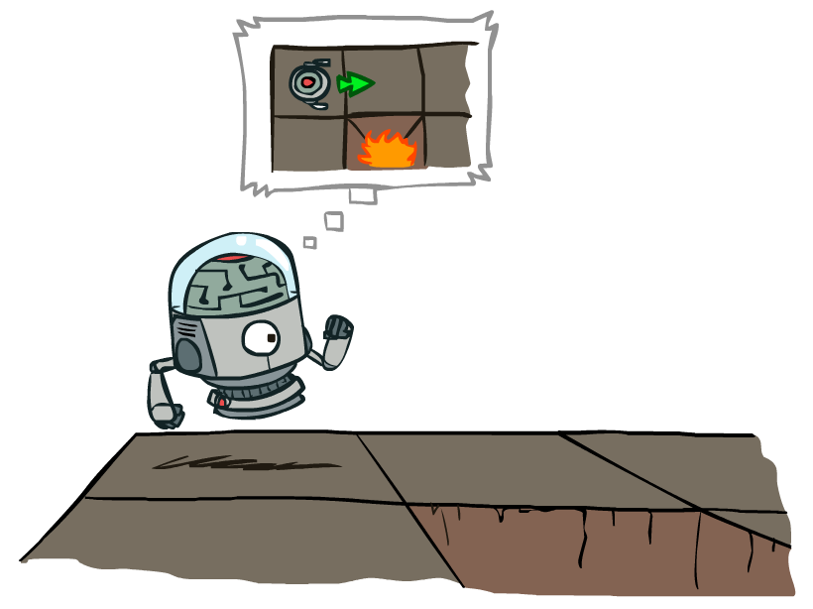
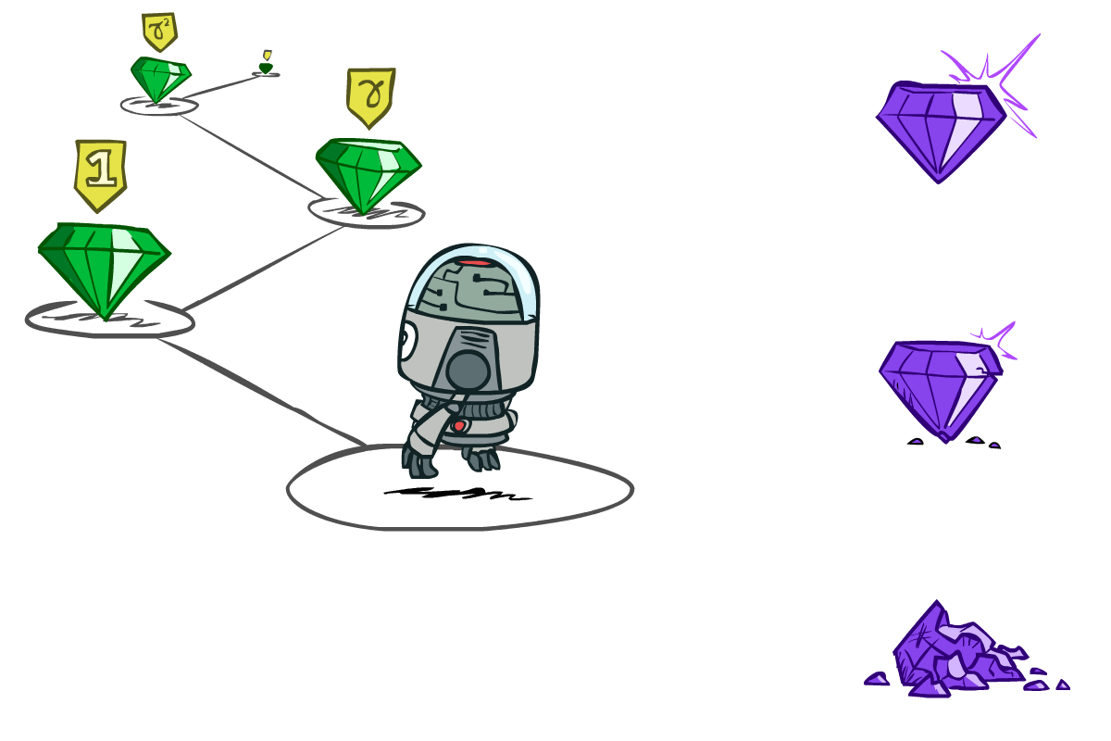
MDP Search Trees
Each MDP state projects an search tree
s
s is a state
a
(s, a) is a q-state
s, a
(s,a,s’) called a transition
T(s,a,s’) = P(s’|s,a)
R(s,a,s’)
s,a,s’
s’
Notes:
In MDP chance node represents uncertainty about what might happen based on (s,a) [as opposed to being a random adversary]
Q-state (s,a) is when you were in a state and took an action

Slide 21
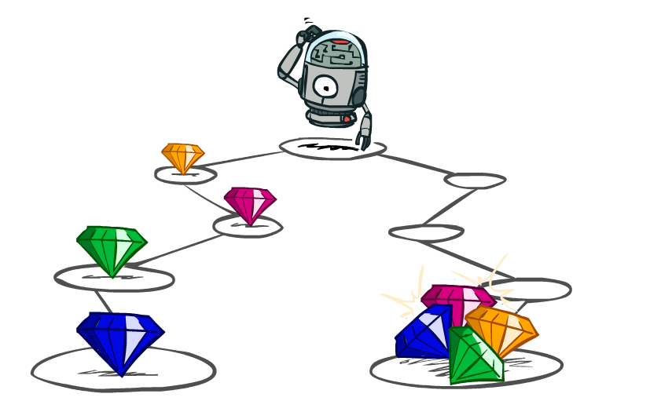
Utilities of Sequences

Slide 22
Utilities of Sequences
What preferences should an agent have over reward sequences?
More or less?
Now or later?
[1, 2, 2]
or
[2, 3, 4]
[0, 0, 1]
or
[1, 0, 0]

Slide 23


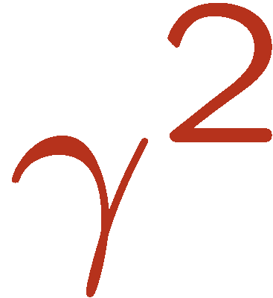

Discounting
It’s reasonable to maximize the sum of rewards
It’s also reasonable to prefer rewards now to rewards later
One solution: values of rewards decay exponentially
Worth Now
Worth Next Step
Worth In Two Steps

Slide 24

Discounting
How to discount?
Each time we descend a level, we multiply in the discount once
Why discount?
Sooner rewards probably do have higher utility than later rewards
Also helps our algorithms converge
Example: discount of 0.5
U([1,2,3]) = 1*1 + 0.5*2 + 0.25*3
U([1,2,3]) < U([3,2,1])
Notes:
Rewards in the future (deeper in the tree) matter less
Interesting: running expectimax, if having to truncate the search, then not losing much; e.g., less then \gamma^d / (1-\gamma)

Slide 25
Discounting
Then: there are only two ways to define utilities
Additive utility:
Discounted utility:

Slide 26
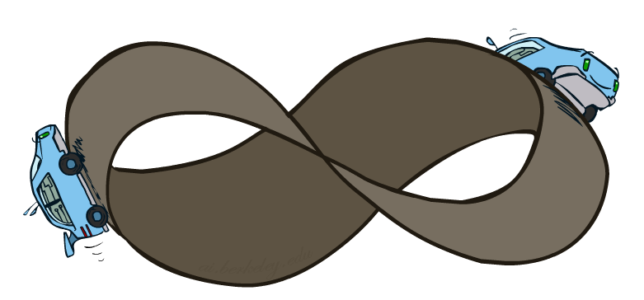
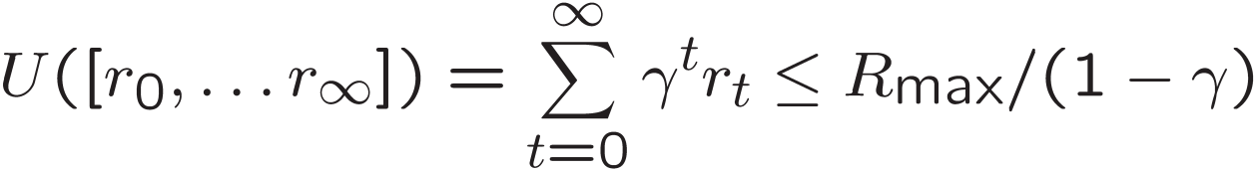
Infinite Utilities?!
Problem: What if the game lasts forever? Do we get infinite rewards?
Solutions:
Finite horizon: (similar to depth-limited search)
Terminate episodes after a fixed T steps (e.g. life)
Gives nonstationary policies (π depends on time left)
Discounting: use 0 < γ < 1
Smaller γ means smaller “horizon” – shorter term focus
Absorbing state: guarantee that for every policy, a terminal state will eventually be reached (like “overheated” for racing)

Slide 27
Solving MDPs

Slide 28
Optimal Quantities
The value (utility) of a state s:
V*(s) = expected utility starting in s and acting optimally
The value (utility) of a q-state (s,a):
Q*(s,a) = expected utility starting out having taken action a from state s and (thereafter) acting optimally
The optimal policy:
π*(s) = optimal action from state s
s
s is a state
a
(s, a) is a q-state
s, a
s,a,s’
(s,a,s’) is a transition
s’
[Demo – gridworld values (L8D4)]
Notes:
[Note: this demo doesn’t show anything in action, just pops up V and Q values.]

Slide 29
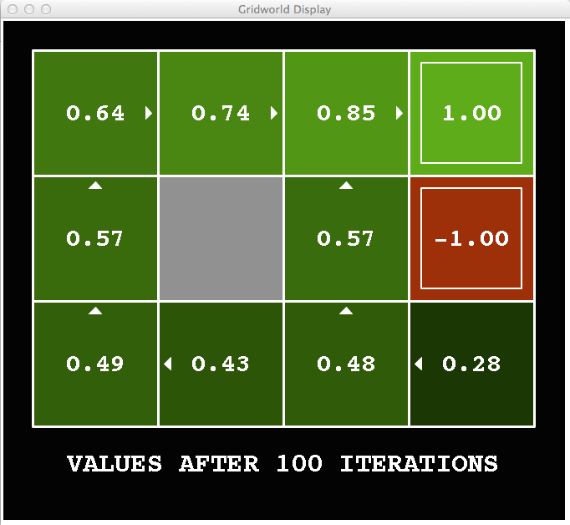
Snapshot of Demo – Gridworld V Values
Noise = 0.2
Discount = 0.9
Living reward = 0
Notes:
This demo doesn’t show anything in action, it just shows the V and Q values.

Slide 30
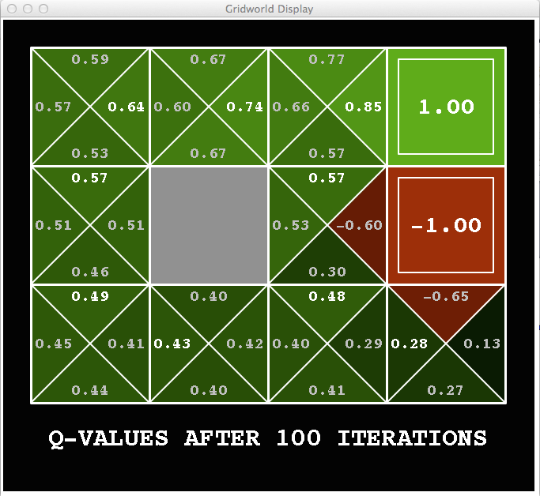
Snapshot of Demo – Gridworld Q Values
Noise = 0.2
Discount = 0.9
Living reward = 0
Notes:
This demo doesn’t show anything in action, it just shows the V and Q values.

Slide 31

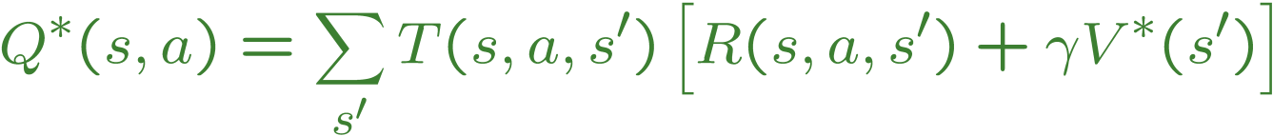
Values of States
Fundamental operation: compute the (expectimax) value of a state
Expected utility under optimal action
Average sum of (discounted) rewards
This is just what expectimax computed!
Recursive definition of value:
s
a
s, a
s,a,s’
s’

Slide 32
Racing Search Tree

Slide 33


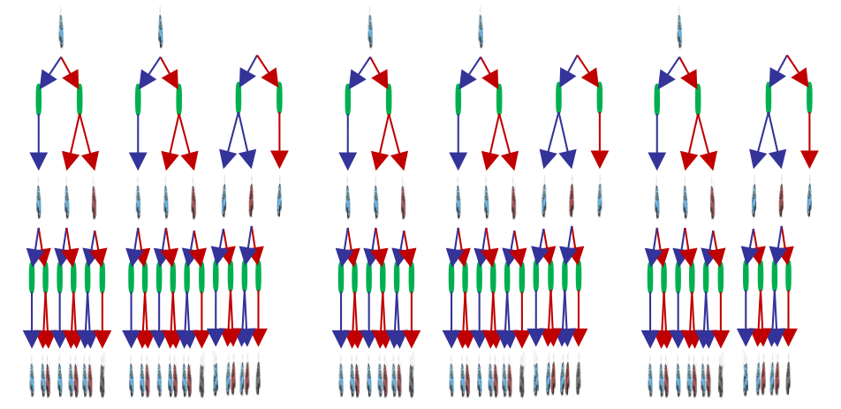

Racing Search Tree
We’re doing way too much work with expectimax!
Problem: States are repeated
Idea: Only compute needed quantities once
Problem: Tree goes on forever
Idea: Do a depth-limited computation, but with increasing depths until change is small
Note: deep parts of the tree eventually don’t matter if γ < 1

Slide 34


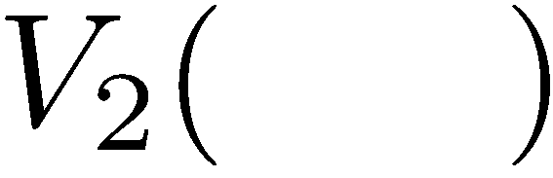


Time-Limited Values
Key idea: time-limited values
Define V_{k}(s) to be the optimal value of s if the game ends in k more time steps
Equivalently, it’s what a depth-k expectimax would give from s
[Demo – time-limited values (L8D6)]
Notes:
This demo generates the time-limited values for gridworld as snapshotted onto the next slides.

Slide 35
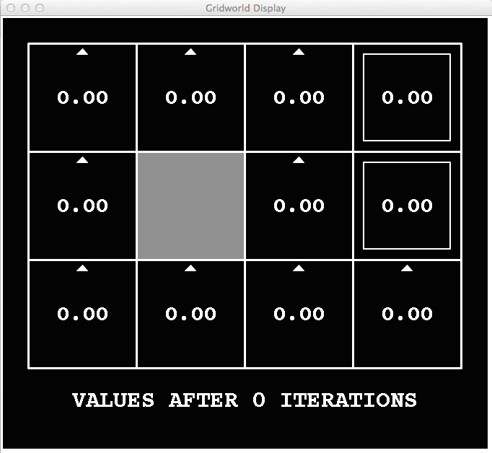
k=0
Noise = 0.2
Discount = 0.9
Living reward = 0
Notes:
Assuming zero living reward

Slide 36
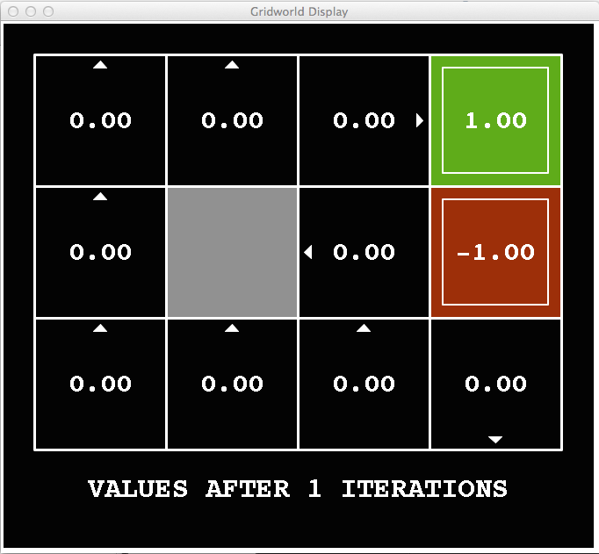
k=1
Noise = 0.2
Discount = 0.9
Living reward = 0
Notes:
Assuming zero living reward

Slide 37
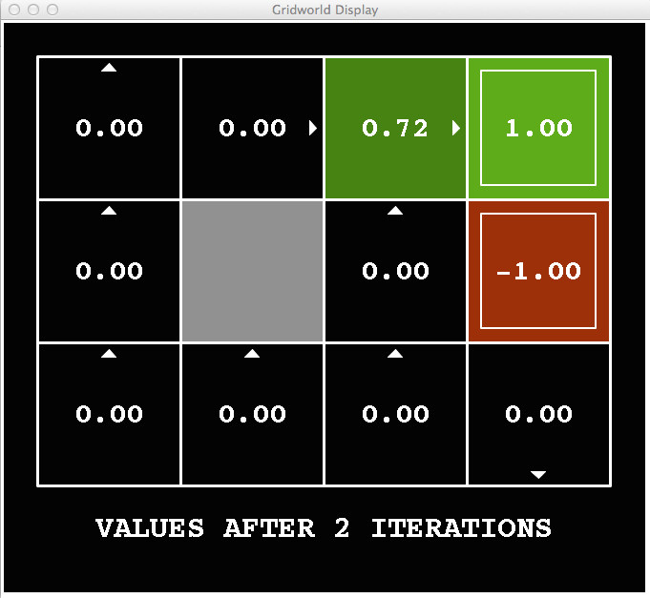
k=2
Noise = 0.2
Discount = 0.9
Living reward = 0
Notes:
Assuming zero living reward
0.9 * 0.8 = 0.72

Slide 38
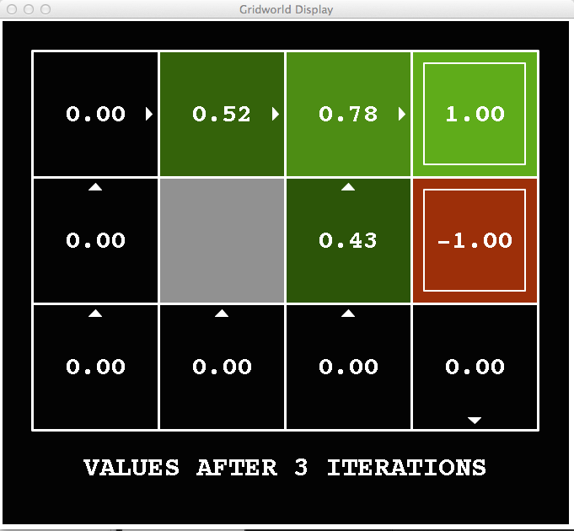
k=3
Noise = 0.2
Discount = 0.9
Living reward = 0
Notes:
Assuming zero living reward

Slide 39
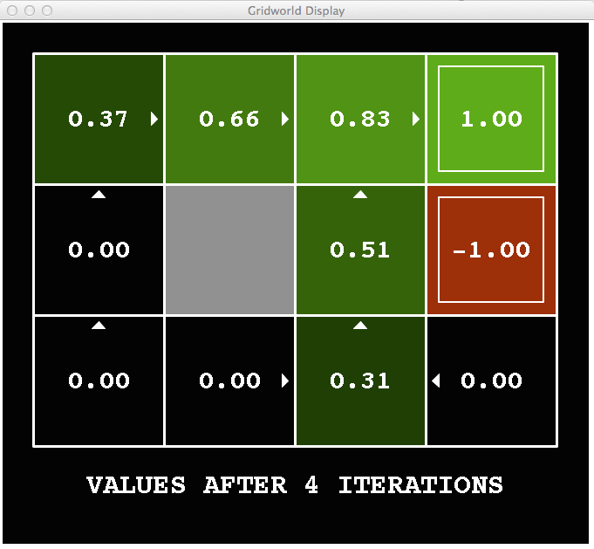
k=4
Noise = 0.2
Discount = 0.9
Living reward = 0
Notes:
Assuming zero living reward

Slide 40
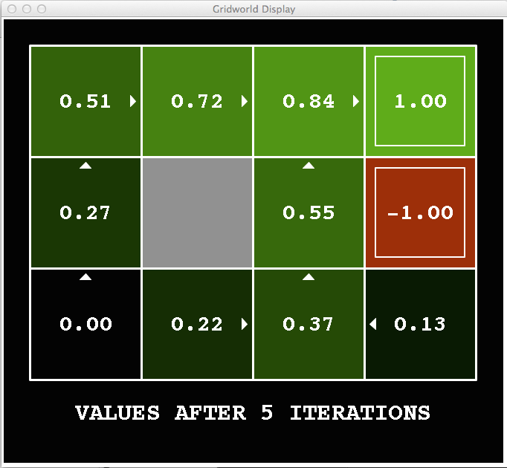
k=5
Noise = 0.2
Discount = 0.9
Living reward = 0
Notes:
Assuming zero living reward

Slide 41
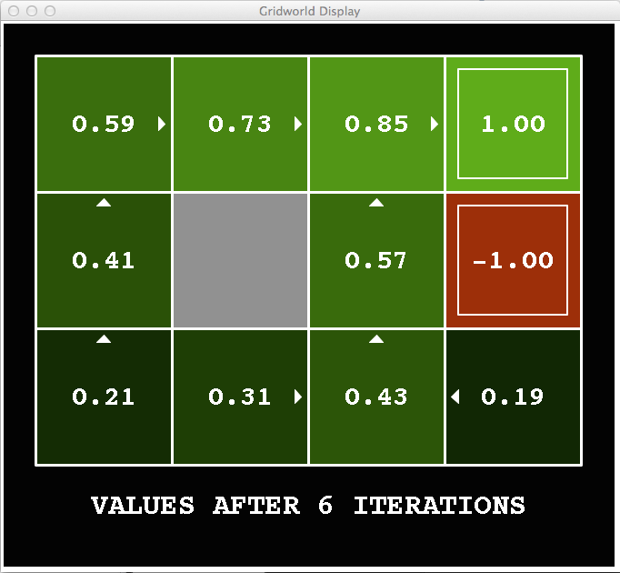
k=6
Noise = 0.2
Discount = 0.9
Living reward = 0
Notes:
Assuming zero living reward

Slide 42
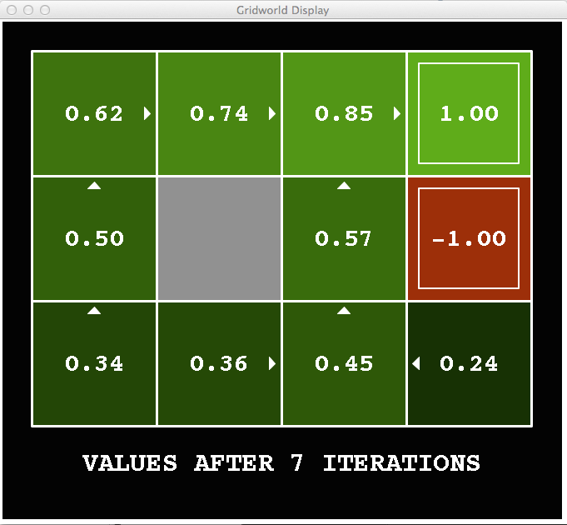
k=7
Noise = 0.2
Discount = 0.9
Living reward = 0
Notes:
Assuming zero living reward

Slide 43
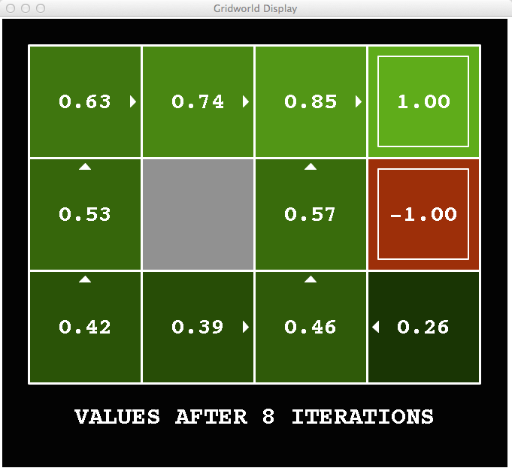
k=8
Noise = 0.2
Discount = 0.9
Living reward = 0
Notes:
Assuming zero living reward

Slide 44
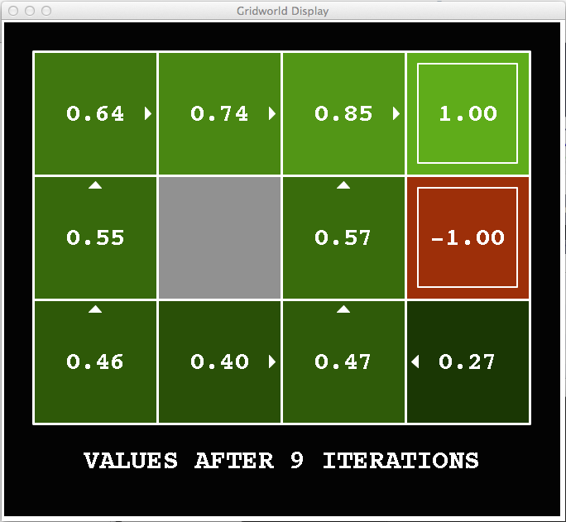
k=9
Noise = 0.2
Discount = 0.9
Living reward = 0
Notes:
Assuming zero living reward

Slide 45

k=10
Noise = 0.2
Discount = 0.9
Living reward = 0
Notes:
Assuming zero living reward

Slide 46

k=11
Noise = 0.2
Discount = 0.9
Living reward = 0
Notes:
Assuming zero living reward

Slide 47

k=12
Noise = 0.2
Discount = 0.9
Living reward = 0
Notes:
Assuming zero living reward

Slide 48

k=100
Noise = 0.2
Discount = 0.9
Living reward = 0
Notes:
Assuming zero living reward

Slide 49
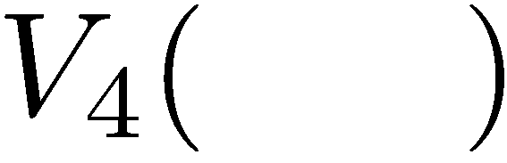

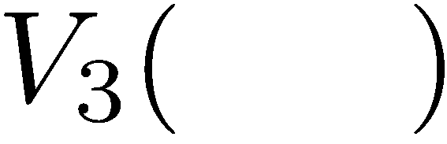
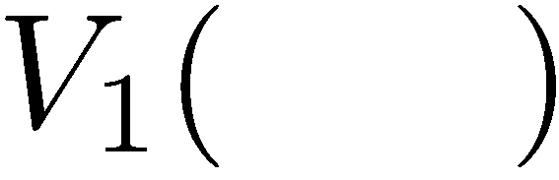
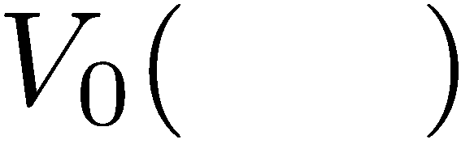
Computing Time-Limited Values

Slide 50
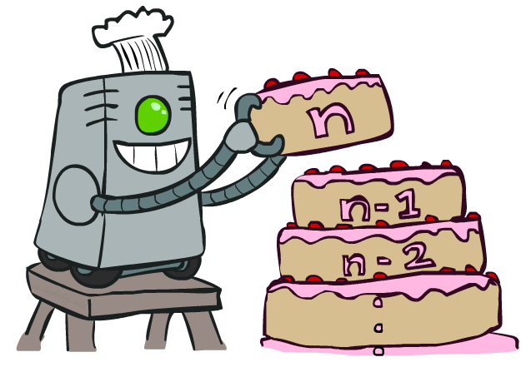
Value Iteration

Slide 51

The Bellman Equations
How to be optimal:
Step 1: Take correct first action
Step 2: Keep being optimal

Slide 52

The Bellman Equations
Definition of “optimal utility” via expectimax recurrence gives a simple one-step lookahead relationship amongst optimal utility values
These are the Bellman equations, and they characterize optimal values in a way we’ll use over and over
s
a
s, a
s,a,s’
s’
Notes:
Let’s start by equations that characterize these quantities through mutual recursions. [step through this by writing on slide, one step at a time]
Recursive characterization of V* in terms of V*; not necessarily helpful; but it is a characterization.
Note: this is a set of equations that needs to be satisfied; but it could have multiple solutions (it does not, but at this stage of our knowledge it could).

Slide 53

Value Iteration
Start with V₀(s) = 0: no time steps left means an expected reward sum of zero
Given vector of V_{k}(s) values, do one ply of expectimax from each state:
Repeat until convergence
Complexity of each iteration: O(S²A)
V_{k+1}(s)
a
s, a
s,a,s’
V_{k}(s’)
Notes:
Discuss computational complexity: S * A * S times number of iterations
Note: updates not in place [if in place, it means something else and not even clear what it means]

Slide 54







Example: Value Iteration
3.5 2.5 0
2 1 0
Assume no discount!
0 0 0

Slide 55

Policy Methods

Slide 56


Policy Evaluation

Slide 57
Utilities for a Fixed Policy
Another basic operation: compute the utility of a state s under a fixed (generally non-optimal) policy
Define the utility of a state s, under a fixed policy π:
V^{π}(s) = expected total discounted rewards starting in s and following π
Recursive relation (one-step look-ahead / Bellman equation):
s
π(s)
s, π(s)
s, π(s),s’
s’

Slide 58

Example: Policy Evaluation
Notes:
Vin = 4/3 + 8/3 + 2/3 Vin
Vin – 2/3 Vin = 12/3
1/3 Vi = 12/3

Slide 59

Policy Evaluation
s
How do we calculate the V’s for a fixed policy π?
Idea 1: Turn recursive Bellman equations into updates
(like value iteration)
Efficiency: O(S²) per iteration
Idea 2: Without the maxes, the Bellman equations are just a linear system
Solve with Matlab (or your favorite linear system solver)
π(s)
s, π(s)
s, π(s),s’
s’

Slide 60

Policy Iteration
Alternative approach for optimal values:
Step 1: Policy evaluation: calculate utilities for some fixed policy (not optimal utilities!) until convergence
Step 2: Policy improvement: update policy using one-step look-ahead with resulting converged (but not optimal!) utilities as future values
Repeat steps until policy converges

Slide 61


Comparison
In value iteration:
Every iteration updates both the values and (implicitly) the policy
We don’t track the policy, but taking the max over actions implicitly recomputes it
In policy iteration:
We do several passes that update utilities with fixed policy (each pass is fast because we consider only one action, not all of them)
After the policy is evaluated, a new policy is chosen (slow like a value iteration pass)
The new policy will be better (or we’re done)

Slide 62
Summary: MDP Algorithms
So you want to….
Compute optimal values: use value iteration or policy iteration
Compute values for a particular policy: use policy evaluation
Turn your values into a policy: use policy extraction (one-step lookahead)
These all look the same!
They basically are – they are all variations of Bellman updates
They all use one-step lookahead expectimax fragments
They differ only in whether we plug in a fixed policy or max over actions

Slide 63



Double Bandits

Slide 64
Double-Bandit MDP
Actions: Blue, Red
States: Win, Lose
No discount
100 time steps
Both states have the same value
0.25 $0
0.75
$2
W
L
0.25
$0
$1
1.0
$1
1.0
0.75 $2

Slide 65
Offline Planning
Solving MDPs is offline planning
You determine all quantities through computation
You need to know the details of the MDP
You do not actually play the game!
No discount
100 time steps
Both states have the same value
0.25 $0
Value
0.75
$2
W
0.25
$0
Play Red
150
L
$1
1.0
$1
1.0
0.75 $2
Play Blue
100

Slide 66
Let’s Play!
$2
$2
$0
$2
$2
$2
$2
$0
$0
$0

Slide 67
Online Planning
Rules changed! Red’s win chance is different.
?? $0
??
$2
W
L
??
$0
$1
1.0
$1
1.0
?? $2

Slide 68
Let’s Play!
$0
$0
$0
$2
$0
$2
$0
$0
$0
$0

Slide 69
What Just Happened?
That wasn’t planning, it was learning!
Specifically, reinforcement learning
There was an MDP, but you couldn’t solve it with just computation
You needed to actually act to figure it out
Important ideas in reinforcement learning that came up
Exploration: you have to try unknown actions to get information
Exploitation: eventually, you have to use what you know
Regret: even if you learn intelligently, you make mistakes
Sampling: because of chance, you have to try things repeatedly
Difficulty: learning can be much harder than solving a known MDP

